Slide 1
From prediction to causation: Causal inference in online systems
Amit Sharma
Postdoc Researcher, Microsoft Research
amshar@microsoft.com
@amt_shrma

Slide 2
Session Objectives and Takeaways
What is causal inference? Why should we care?
Predictive algorithms depend on correlations.
Correlations alone are a dangerous path to actionable insights.
Learn about reasoning with graphical models and methods for causal inference.
These methods are also practical. We will apply them to estimate the impact of a recommendation system.

Slide 3
Predictive systems are everywhere
Recommender Systems
Search Engines
Ad placement
Fraud detection
Dating websites

Slide 4
How do predictive systems work?
For a user, we see data about their user profile and past activity.
E.g., for any user, we might see their age, gender, past activity and their social network.
We would like to predict future activity.

Slide 5
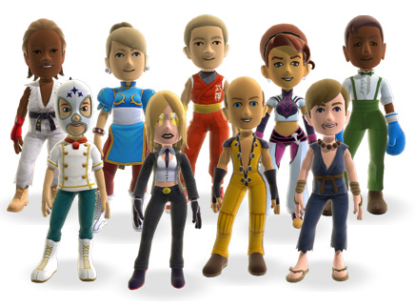
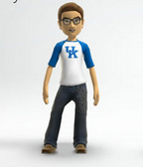

From data to prediction
Higher Activity Lower Activity
✗
Use these correlations to make a predictive model.
Future Activity ->
f(number of friends, logins in past month)

Slide 6
From data to “actionable insights”
Number of friends can predict activity with high accuracy.
How do we increase activity of users?
Would increasing the number of friends increase people’s activity on our system?
Maybe, may be not (!)

Slide 7
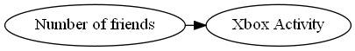
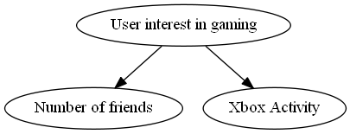
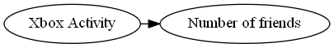
Different explanations possible
How do we know what causes what?
Decision: To increase activity, would it make sense to launch a campaign to increase friends?
Notes:
Edges represent causal connections. Each node is a variable that represents a quantity of interest.

Slide 8

Another example: Search Ads
Search engines uses ad targeting to show relevant ads.
Prediction model based on user’s search query.
Search Ads have the highest clickthrough rate (CTR) in online ads.

Slide 9
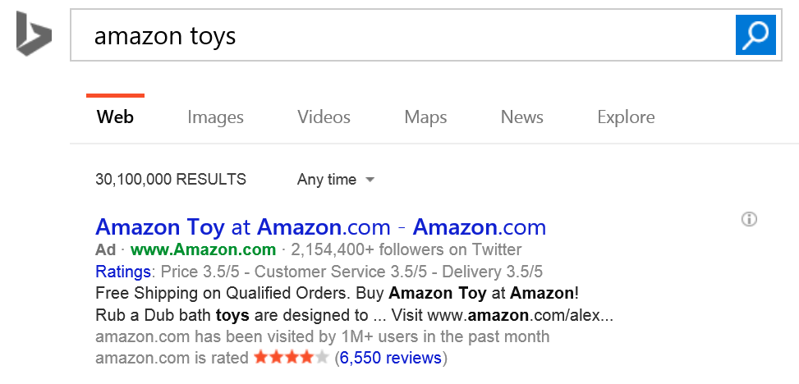
Are search ads really that effective?
Ad targeting was highly accurate.

Slide 10
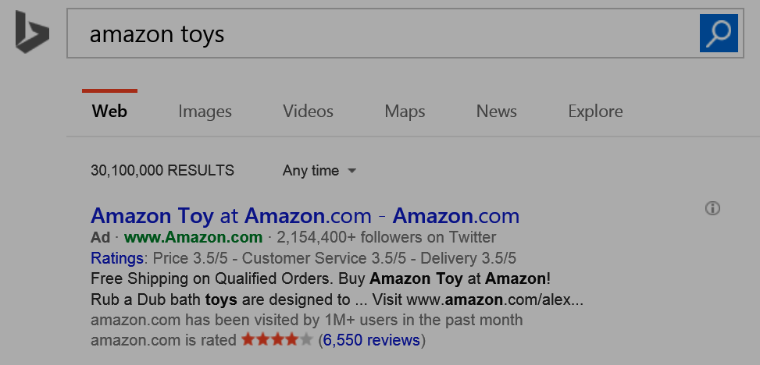
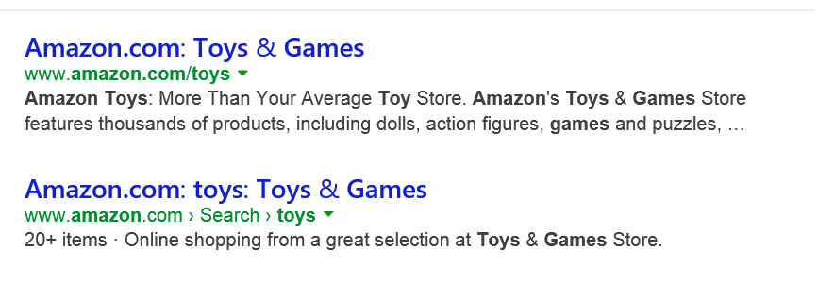
But search results point to the same website
Counterfactual question: Would I have reached Amazon.com anyways, without the ad?

Slide 11
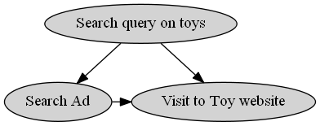
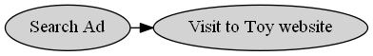
Without reasoning about causality, may overestimate effectiveness of ads
x% of ads shown are effective
<x% of ads shown are effective

Slide 12

Okay, search ads have an explicit intent. Display ads should be fine?
Probably not.
There can be many hidden causes for an action, some of which may be hard to quantify.

Slide 13


Estimating the impact of ads
Toys R Us designs new ads.
Big jump in clicks to their ads compared to past campaigns. Were these ads more effective?
Notes:
It’s December, holiday season!
So Toys R Us decides to show ads for toys everywhere

Slide 14
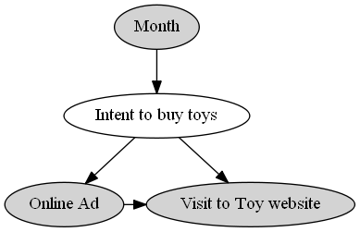
People anyways buy more toys in December
Misleading to compare ad campaigns with changing underlying demand.

Slide 15
So far, so good. Be mindful of hidden causes, or else we might overestimate causal effects.

Slide 16
(But) Ignoring hidden causes can also lead to completely wrong conclusions.

Slide 17
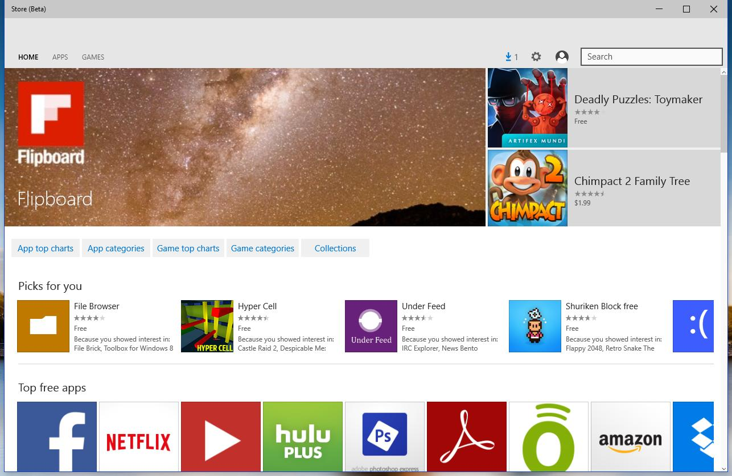
Example: Which algorithm is better?
Have a current production algorithm. Want to test if a new algorithm is better.
Say recommendations on app store.
?
Algorithm A
Algorithm B

Slide 18
Comparing old versus new algorithm
Two algorithms, A (production) and B (new) running on the system.
From system logs, collect data for 1000 sessions for each. Measure CTR.
Old Algorithm (A) | New Algorithm (B)
50/1000 (5%) | 54/1000 (5.4%)
New algorithm is better?

Slide 19
Frequent users of the Store tend to be different from new users
So let us look at CTR separately.
Old Algorithm (A) | New Algorithm (B)
10/400 (2.5%) | 4/200 (2%)
High-activity Users
Old Algorithm (A) | New Algorithm (B)
40/600 (6.6%) | 50/800 (6.2%)
Low-activity Users

Slide 20
The Simpson’s paradox
 | Old algorithm (A) | New Algorithm (B)
CTR for Low-Activity users | 10/400 (2.5%) | 4/200 (2%)
CTR for High-Activity users | 40/600 (6.6%) | 50/800 (6.2%)
Total CTR | 50/1000 (5%) | 54/1000 (5.4%)
Is Algorithm A better?

Slide 21
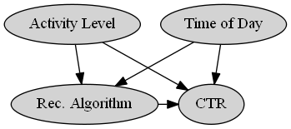
May be, may be not.
E.g., Algorithm A could have been shown at different times than B.
There could be other hidden causal variations.

Slide 22

Making sense of such data can be too complex.

Slide 23
Key Question: How can we systematically formulate, test and estimate causal effects?
Causal inference: Principled basis for both experimental and non-experimental methods.
Aside: Such questions form the basis of almost all scientific inquiry.
E.g., occur in medicine (drug trials, effect of a drug), social sciences (effect of a certain policy), and genetics (effect of genes on disease).

Slide 24
What does it mean to cause?
A big philosophical debate (since the times of Aristotle, Hume and others).
Practical meaning: X causes Y iff
changing X leads to a change in Y,
keeping everything else constant.
The causal effect is the magnitude by which Y is changed by a unit change in X.

Slide 25





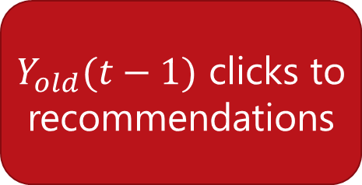
Why is it hard?
Naïve estimate
$$Y_{new}(t)−Y_{old}(t−1)$$
Old Algorithm
$Y_{old}(t−1)$ clicks to recommendations
Causal estimate
$$Y_{new}(t)−Y_{old}(t)$$
New Algorithm
Old Algorithm
$Y_{new}(t)$ clicks to recommendations
$Y_{old}(t)$ clicks to recommendations
Cloned user

Slide 26
Need answers to “what if” questions
Basic construct of causal inference.
Counterfactual thinking:
What would have happened if I had changed X?
E.g. What would have been the CTR had we not shifted to the new algorithm?

Slide 27
Methods for answering causal questions
Randomization
A/B test
Multi-armed bandits
Natural Experiments
Regression discontinuity
Instrumental Variables
Conditioning
Stratification
Propensity Score Matching
VALIDITY
EASE OF USE
Notes:
Fortunately, causal inference is an active field of research.

Slide 28
Randomization to the rescue

Slide 29
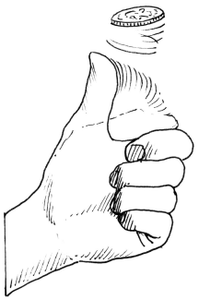
Randomizing algorithm assignment: A/B test
We cannot clone users.
Next best alternative: Randomly assign which users see new Algorithm’s recommendations and which see the old algorithm’s.

Slide 30
Randomization removes hidden variation
Old Algorithm
$Y_{old}(t−1)$ clicks to recommendations
…
Causal estimate
$$Y_{new}(t)−Y_{old}(t)$$
New Algorithm
Old Algorithm
$Y_{new}(t)$ clicks to recommendations
$Y_{old}(t)$ clicks to recommendations
Random User 1
Random User 2

Slide 31
Cost: Possibly bad user experience for many users
Say the new algorithm was really bad.
Can decrease the percentage of users who see the new algorithm, but how do we know this beforehand?
Such manual tweaks even more inefficient if multiple algorithms to test.

Slide 32

Efficient randomization: Multi-armed bandits
Two goals:
Show the best known algorithm to most users.
Keep randomizing to update knowledge about competing algorithms.

Slide 33

Bandits: The right mix of explore and exploit
Old Algorithm
$Y_{old}(t−1)$ clicks to recommendations
…
Current-best Algorithm
Random Algorithm
$Y_{new}(t)$ clicks to recommendations
$Y_{rand}(t)$ clicks to recommendations
Most users
Other users

Slide 34
Algorithm: ɛ-greedy multi-armed bandits
Repeat:
(Explore) With low probability ɛ, choose an output item randomly.
(Exploit) Otherwise, show the current-best algorithm.
Use CTR results for Random output items to train new algorithms offline.

Slide 35
Caveat: Not always feasible to randomize, or ensure that people fully comply
Randomization may be too expensive or involve ethical hazards.
There may not be perfect compliance with random assignment. E.g. referral experiment for Xbox Gold.
Even when feasible, randomization methods need a limited set of "good" alternatives to test.
How do we identify a good set of algorithms or a good set of parameters?
Common metrics like CTR will not be useful, because they might miss hidden causes.
Need causal metrics.

Slide 36
So how about naturally occurring experiments?

Slide 37
“Natural” experiments: exploit variation in observed data
Can exploit naturally occurring close-to-random variation in data.
Since data is not randomized, need assumptions about the data-generating process.
If there is sufficient reason to believe the assumptions, we can estimate causal effects.

Slide 38
Example: Effect of Store recommendations
Suppose instead of comparing recommendation algorithms, we want to estimate the causal effect of showing any algorithmic recommendation.
Can be used to benchmark how much revenue a recommendation system brings, and allocate resources accordingly.
(and perhaps help analyze the tradeoff with users’ privacy)

Slide 39
Exploiting arbitrary cutoffs to recommendations
Only 3 recommendations shown to user.

Slide 40

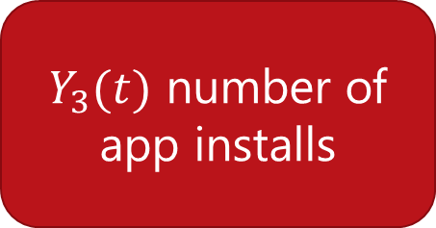
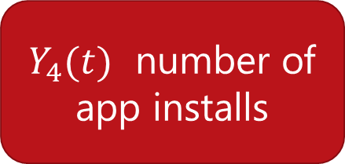
Assumption: Closely-ranked not-shown apps are as relevant as shown apps
Causal effect of being shown as recommendation
$$Y_{3}(t)−Y_{4}(t)$$
3rd ranked app (Shown)
4th ranked app
(Not-shown)
$Y_{3}(t)$ number of app installs
$Y_{4}(t)$ number of app installs
Same user

Slide 41
Algorithm: Regression discontinuity
For any top-k recommendation list:
Using logs, identify apps that were similarly ranked but could not make it to the top-k shown apps.
Measure difference in app installs between shown and not-shown apps for each user.

Slide 42
Another natural experiment
Can look at as-if random variations due to external events.
E.g. Featuring on the Today show may lead to a sudden spike in installs for an app.
Such external shocks can be used to determine causal effects, such as the effect of showing recommendations.

Slide 43
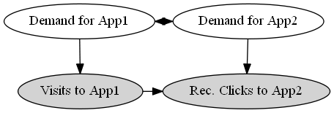

Cont. example: Effect of store recommendations
How many new visits are caused by the recommender system?
Demand for App 1 is correlated with demand for App 2.
$⇒$ Users would most likely have visited App 2 even without recommendations.

Slide 44
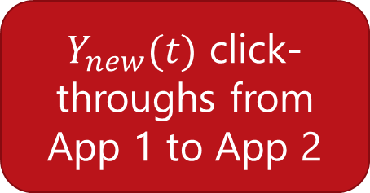
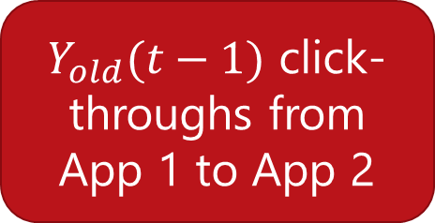
Traffic on normal days to App 1
$Y_{old}(t−1)$ click-throughs from
App 1 to App 2
Cannot say much about the causal effect of recommendations from App 1.
$Y_{new}(t)$ click-throughs from
App 1 to App 2

Slide 45

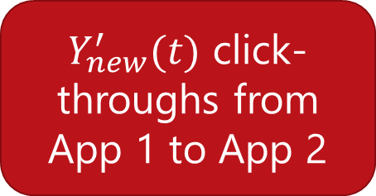
External shock brings as-if random users to App1
$Y_{old}(t−1)$ click-throughs from
App 1 to App 2
Spike in visits to App 1
If demand for App 2 remains constant, additional views to App 2 would not have happened had these new users not visited App 1.
$$Causal clicks =Y_{new}^{′}\left(t\right)−Y_{old}(t−1)$$
$Y_{new}^{′}(t)$ click-throughs from
App 1 to App 2

Slide 46
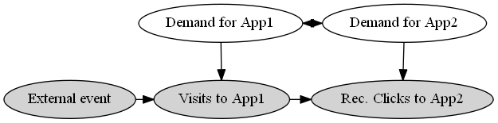

Exploiting sudden variation in traffic to App 1
To compute Causal CTR of Visits to App1 on Visits to App2:
Compare observed effect of external event separately on Visits to App1, and on Rec. Clicks to App2.
Causal click-through rate =$\frac{\text{Δ}\text{(}\text{Rec}\text{. }\text{Click}\text{−}\text{throughs} \text{from} \text{App}\text{1 }\text{to} \text{App}\text{2)}}{\text{Δ}\text{(}\text{Visits} \text{to} \text{App}\text{1)}}$

Slide 47
Caveat: Natural experiments are hard to find
Estimates may not be generalizable to all products.
Both sources of experimentation:
Controlled
Natural
ruled out.
Can we estimate causal effects with only observational data?

Slide 48
What can we conclude with only observed data?

Slide 49
Imagine a randomized experiment…
Old Algorithm
$Y_{old}(t−1)$ clicks to recommendations
…
New Algorithm
Old Algorithm
$Y_{new}(t)$ clicks to recommendations
$Y_{old}(t)$ clicks to recommendations
Random User 1
Random User 2
Notes:
Imagine we did an experiment, where we randomized algorithm.
But we did not, so need to account for the hidden causes=> compare CTR between algorithms only for people with similar activity.

Slide 50

Compare with a similar user instead of random
Old Algorithm
$Y_{old}(t−1)$ clicks to recommendations
…
Causal estimate
$≈ Y_{new}(t)−Y_{old}(t)$
New Algorithm
Old Algorithm
$Y_{new}(t)$ clicks to recommendations
$Y_{old}(t)$ clicks to recommendations
User 1
Similar User 2
Notes:
Imagine we did an experiment, where we randomized algorithm.
But we did not, so need to account for the hidden causes=> compare CTR between algorithms only for people with similar activity.

Slide 51
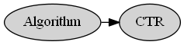
Continuing example: Effect of Algorithm on CTR
Does new Algorithm B increase CTR for recommendations on Windows Store, compared to old algorithm A?
Make assumptions about how the data as generated.
Create a graphical model representing those assumptions.

Slide 52
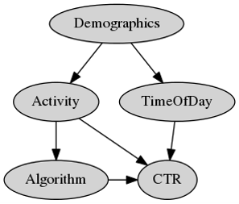
Previous example: Effect of Algorithm over CTR
Does new Algorithm B increase CTR for recommendations on Windows Store, compared to old algorithm A?
Make assumptions about how the data as generated.
Create a graphical model representing those assumptions.
Notes:
Validity of estimate depends on validity of these assumptions.

Slide 53

Assumptions to estimate effect of Algorithm
$Activity$ level of users affects which $Algorithm$ they are shown and their overall $CTR$.
$CTR$ is different at different times of day.
Unobserved $Demographics$ of a user determine when they visit the Store, which also affects their $Activity$ level, and in turn the $Algorithm$ they are shown.

Slide 54

General method: Conditioning on variables
Intuition: Compare effect of algorithm on similar users.
$⇒$Compare users with the same activity level.
Steps:
Stratify log data based on activity levels.
Compare CTR of different algorithms within these strata.

Slide 55
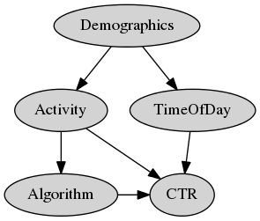

Should we also restrict our comparison to people who come at the same times?
$CTR$ does depend on $Time of Day$ of a user’s visit.
But the algorithm assigned does not change based on $Time of Day$.
$⇒$ While $CTR$ may be different at different times, any $Algorithm$ is equally likely to be shown at any point in time.

Slide 56
Tricky to find correct variables to condition on. Fortunately, graphical models make it precise.
Backdoor paths: Look for (undirected) paths that point to both $Algorithm$ and $CTR$.
Notes:
Causal paths that bias estimation

Slide 57
Backdoor criterion: Condition on enough variables to cover all backdoor paths

Slide 58
Algorithm: Stratification
With observational data:
Assume a graphical model that explains how the data was generated.
Choose variables to condition on using backdoor criterion.
Stratify data into subsamples such that each subsample has the same value of all conditioned variables.
Evaluate the difference in outcome variable separately within these strata.
(Optional) Aggregate over all data.

Slide 59
Stratification may be inefficient if there are multiple hidden causes
Stratification creates tiny strata when data is high-dimensional. Hard to obtain stable estimates.
E.g. activity data may be high-dimensional: a vector for purchases in each app category.
Key Idea: Instead of conditioning on all relevant attributes, can condition on the likelihood of being assigned an Algorithm.

Slide 60
This was stratification…
Old Algorithm
$Y_{old}(t−1)$ clicks to recommendations
User 2 and User 1 are the same on all relevant attributes.
…
New Algorithm
Old Algorithm
$Y_{new}(t)$ clicks to recommendations
$Y_{old}(t)$ clicks to recommendations
User 1
Similar User 2
Notes:
Imagine we did an experiment, where we randomized algorithm.
But we did not, so need to account for the hidden causes=> compare CTR between algorithms only for people with similar activity.

Slide 61
Instead condition on propensity to new Algorithm
Old Algorithm
$Y_{old}(t−1)$ clicks to recommendations
User 2 and User 1 are equally likely to be shown New Algorithm.
…
New Algorithm
Old Algorithm
$Y_{new}(t)$ clicks to recommendations
$Y_{old}(t)$ clicks to recommendations
User 1
Similar User 2

Slide 62


Continued example: Effect of Algorithm on CTR
Based on backdoor criterion, need to condition only on Activity.
Activity is multi-dimensional.
$$Activity=(a_{cat1}, a_{cat2}, …a_{catn})$$
Estimate likelihood to be shown New Algorithm using observed Algorithm-user pairs.
$$Propensity_{NewAlgo}\left(User_{i}\right)=Logistic(a_{cat1}, a_{cat2}, …a_{catn})$$
Compare CTR between users with the same propensity score.

Slide 63
Algorithm: Propensity score matching
With observational data:
Assume a graphical model that explains how the data was generated.
Choose variables to condition on using backdoor criterion.
Compute propensity score for each user based on conditioned variables.
Match pairs of individuals with similar scores, where one of them saw Old Algorithm and the other saw New Algorithm.
Compare the outcome variable within each such matched pair and aggregate.

Slide 64
Caveat: Causal effect only if assumed graphical model is correct
There might be unknown and unobserved causes that might affect an Algorithm’s CTR.
E.g. early adopters, more tech-savvy, or another characteristic.
There might be known unobserved user features.
E.g. their age or the context in which they use Windows store.
At best, conditioning offers strong hints to causality.

Slide 65
Key takeaways
Amit Sharma (@amt_shrma)
Microsoft Research, New York

Slide 66
Causal inference: Best practices
Whenever possible, use randomization.
If number of output items low, consider using multi-world testing.
If randomization is not feasible, consider exploiting natural experiments.
Better to consider multiple sources of natural experiments.
If natural experiments are hard to find, consider using conditioning methods.
Use them as strong hints for causality.

Slide 67
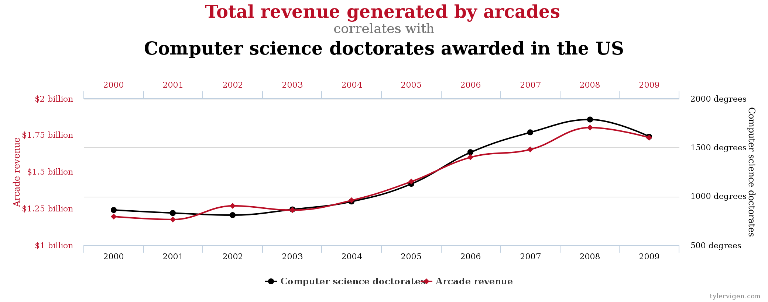
Causal inference is tricky Correlations are seldom enough. And sometimes horribly misleading. Always be skeptical of causal claims from observational any data. More data does not automatically lead to better causal estimates.
*tylervigen.com

Slide 68
Hands-on tutorial

Slide 69
Code and resources available at
http://www.github.com/amit-sharma/causal-inference-tutorial
Contact: amshar@microsoft.com, @amt_shrma

Slide 70
Prerequisites
Need R, Rstudio.
Packages: dplyr, ggplot2
1. Install them using:
install.packages(“dplyr”)
install.packages(“ggplot2”)
2. Clone git repository
https://www.github.com/amit-sharma/causal-inference-tutorial

Slide 71
Gameplan
Study the effect of app store recommendation system.
Using system logs,
Compare two recommendation algorithms.
Estimate the causal effect of recommendations.

Slide 72
I. Which of the two algorithms is better?
Situation: Two Algorithms, A and B, were used to show app recommendations on the Store.
Data: System log data recording users’ visits.
Causal question: Which algorithm leads to higher click-through rates?

Slide 73
Loading user-app visits data
source(‘estimate_causal_effect.R')
user_app_visits_A = read.csv("user_app_visits_A.csv")

Slide 74
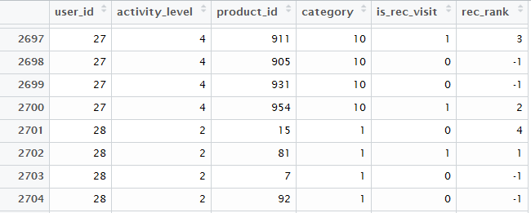
Dataset at a glance

Slide 75
Data description
user_id: Unique ID for user
activity_level: User’s activity level. Discrete (1:Lowest, 4:Highest)
product_id: Unique ID for an app
category: Category for an app (e.g. productivity, music, etc.)
is_rec_visit: Whether the app visit came through a recommendation click-through.
rec_rank: Rank in the recommendation list (only top-3 apps shown to user, -1 means that app was not in the recommendation list)

Slide 76
What’s in the dataset?
> nrow(user_app_visits_A)
[1] 1,000,000
> length(unique(user_app_visits_A$user_id))
[1] 10,000
> length(unique(user_app_visits_A$product_id))
[1] 990
> length(unique(user_app_visits_A$category)) [1] 10

Slide 77
Causal assumptions
We ask the system designers/look at the source code for the system.
Algorithm was selected based on activity level of users.
Further, CTR depends on
Activity level
Time of day
App category

Slide 78
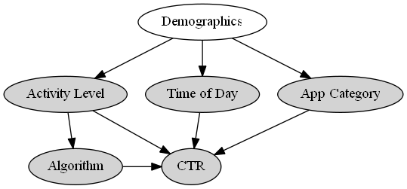
Graphical model to compare CTR of algorithms

Slide 79
Naïve estimate for comparing algorithms
> user_app_visits_B = read.csv("user_app_visits_B.csv")
> naive_observational_estimate <- function(user_visits){
# Naive observational estimate
# Simply the fraction of visits that resulted in a recommendation click-through.
est =
summarise(user_visits, naive_estimate=sum(is_rec_visit)/length(is_rec_visit))
return(est)
}
> naive_observational_estimate(user_app_visits_A)
naive_estimate
[1] 0.200768
> naive_observational_estimate(user_app_visits_B)
naive_estimate
[1] 0.226467

Slide 80
Using backdoor criterion, identify correct variables on condition on

Slide 81
Stratified estimate for comparing algorithms
> stratified_by_activity_estimate(user_app_visits_A)
Source: local data frame [4 x 2]
activity_level stratified_estimate
1 1 0.1248852
2 2 0.1750483
3 3 0.2266394
4 4 0.2763522
> stratified_by_activity_estimate(user_app_visits_B)
Source: local data frame [4 x 2]
activity_level stratified_estimate
1 1 0.1253469
2 2 0.1753933
3 3 0.2257211
4 4 0.2749867

Slide 82
If we had conditioned on category…
> stratified_by_category_estimate(user_app_visits_A)
Source: local data frame [10 x 2]
category stratified_estimate
1 1 0.1758294
2 2 0.2276829
3 3 0.2763157
4 4 0.1239860
5 5 0.1767163
… … …
> stratified_by_category_estimate(user_app_visits_B)
Source: local data frame [10 x 2]
category stratified_estimate
1 1 0.2002127
2 2 0.2517528
3 3 0.3021371
4 4 0.1503150
5 5 0.1999519
… … …

Slide 83
I. Which of the two algorithms is better?
The two Algorithms lead to roughly the same CTR.
Answer: Both are equally effective.
Still, the CTR estimate must be an over-estimate of the causal effect of recommendations, as people might have visited some of the apps anyways.
How to estimate the causal effect?

Slide 84
II. What is the causal effect of the recommendation system?
Situation: Two Algorithms, A and B, were used to show app recommendations on the Store.
Data: System logs containing user-app visits.
Causal question: How many apps would users have visited in case no recommendations were shown?

Slide 85
Graphical model to estimate causal effect
We observe total recommendation click-throughs.
But some of them may be due to correlated demand.

Slide 86
Using regression discontinuity analysis
Observe that the Store only shows top-3 recommendations.
Comparing number of visits to the 4th ranked app (not shown to the user) with the 3rd ranked app can be used to estimate the effect of showing a recommendation.
(Assuming 3rd and 4th ranked apps are equally relevant to a user)

Slide 87
Discontinuity estimate for recommendations
> naive_observational_estimate(user_app_visits_A)
naive_estimate
[1] 0.200768
> ranking_discontinuity_estimate(user_app_visits_A)
discontinuity_estimate
[1] 0.121362
40% of app visits coming from recommendation click-throughs are not causal.
Could have happened even without the recommendation system.

Slide 88
Causal inference: Best practices
Whenever possible, use randomization.
If number of output items low, consider using multi-world testing.
If randomization is not feasible, consider exploiting natural experiments.
Better to consider multiple sources of natural experiments.
If natural experiments are hard to find, consider using conditioning methods.
Use them as strong hints for causality.

Slide 89
Thank you!

